Slide 1
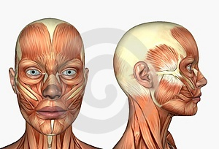
Anatomy of the face
By
Dr.Ibrahim Falih

Slide 2
Scalp
The scalp is the part of the head that extends from the superciliary arches anteriorly to the external occipital protuberance and superior nuchal lines posteriorly.
Laterally it continues inferiorly to the zygomatic arch.

Slide 3
Scalp

Slide 4
Scalp
The scalp is a multilayered structure with layers that can be defined by the word itself:
S-skin
C-connective tissue (dense)
A-aponeurotic layer (galea aponeurotica)
L-loose connective tissue
P-pericranium

Slide 5
Scalp
The first three layers are tightly held together, forming a single unit.
This unit is sometimes referred to as the scalp proper and is the tissue torn away during serious 'scalping' injuries.

Slide 6
Scalp

Slide 7
Scalp
Skin is thick, hair bearing and contains numerous sebaceous glands.
Connective tissue is fibrofatty, the fibrous septa uniting the skin to the underlying aponeurosis of the occipitofrontalis muscle. Numerous arteries and veins are found in this layer. The arteries are branches of the external and internal carotid arteries, and a free anastomosis takes place between them.
Aponeurosis (epicranial) is a thin, tendinous sheet that unites the occipital and frontal bellies of the occipitofrontalis muscle. The lateral margins of the aponeurosis are attached to the temporal fascia.

Slide 8
Scalp
Loose areolar tissue occupies the subaponeurotic space and loosely connects the epicranial aponeurosis to the periosteum of the skull (the pericranium). The areolar tissue contains a few small arteries, but it also contains some important emissary veins. The emissary veins are valveless and connect the superficial veins of the scalp with the diploic veins of the skull bones and with the intracranial venous sinuses.
Called dangerous layer of scalp-emissary veins open here and carry any infections inside the brain (venous sinus).
Bleeding lead to black eye.
Pericranium, which is the periosteum covering the outer surface of the skull bones.

Slide 9
Muscle of the Scalp
Occipitofrontalis Muscle
It has a frontal belly anteriorly, an occipital belly posteriorly, and an aponeurotic tendon (epicranial aponeurosis) connecting the two.
Muscle | Origin | Insertion | Nerve Supply | Action
Occipitofrontalis
occipital belly | Highest nuchal line of occipital bone | Epicranial aponeurosis | Facial nerve | Moves scalp on skull and raises eyebrows
frontal belly | Skin and superficial fascia of eyeborw

Slide 10
Sensory innervations of the scalp
It is from two major sources, cranial nerves or cervical nerves, depending on whether it is anterior or posterior to the ears and the vertex of the head.
Anterior to the ears and the vertex
Posterior to the ears and the vertex

Slide 11
Sensory innervations of the scalp
Posterior to the ears and the vertex
Anterior to the ears and the vertex
Supratrochlear nerve
Supraorbital nerve
Zygomaticotemporal nerve
Auriculotemporal nerve
By branches of all four divisions of the trigeminal nerve
Great auricular nerve
Lesser occipital nerve
Greater occipital nerve
Third occipital nerve
By branches of all four divisions of the spinal cutaneous nerves (C2 and C3)

Slide 12
Sensory innervations of the scalp

Slide 13
Arterial Supply of the Scalp
Arteries supplying the scalp are branches of either the external carotid artery
or the ophthalmic artery which is a branch of the internal carotid artery.

Slide 14
Arterial Supply of the Scalp
External carotid arteries
Internal carotid arteries
Occipital arteries
Posterior auricular arteries
Superficial temporal arteries
Supratrochlear arteries
Supraorbital arteries

Slide 15
Arterial Supply of the Scalp

Slide 16
Venous Drainage of the Scalp
Veins draining the scalp follow a pattern similar to the arteries.
Of the deep parts of the scalp
Via emissary veins that communicates with the dural sinuses.

Slide 17
Lymphatic Drainage of the Scalp
Lymphatic drainage of the scalp generally follows the pattern of arterial distribution.
The lymphatics in the occipital region initially drain to occipital nodes which drain into upper deep cervical nodes.

Slide 18
Lymphatic Drainage of the Scalp
Lymphatics from the upper part of the scalp drain in two directions:
Posterior to the vertex of the head they drain to mastoid nodes.
Anterior to the vertex of the head they drain to pre-auricular and parotid nodes.

Slide 19
Lymphatic Drainage of the Scalp

Slide 20
Face
Boundaries
Extends superiorly to the hair line, inferiorly to the chin and base of mandible, and on each side to auricle
Forehead is common to both scalp and face.

Slide 21
Face
Very vascular
Due to rich vascularity face flush and blanch.
Facial skin is rich in sebaceous gland and sweat gland.
Wounds of face bleed profusely but heal rapidly.
Sebaceous gland keep the skin oily but also cause acne in adult.

Slide 22
Face
Muscles of the face called muscle of facial expression and lie in superficial fascia.
Embryologically they develop from mesoderm of 2nd branchial arch, therefore supplied by facial nerve.
No deep fascia is present in the face.

Slide 23
Bones of the Face
The facial skeleton consists of 14 stationary bones and the mandible.
These 14 bones form the basic shape of the face, and are responsible for providing attachments for muscles that make the jaw move and control facial expressions.

Slide 24
Bones of the Face

Slide 25
Muscles of the Face (Muscles of Facial Expression)
The muscles of the face develop from the 2nd pharyngeal arch and are innervated by branches of the facial nerve [VII].
They are in the superficial fascia, with origins from either bone or fascia, and insertions into the skin.
these muscles control expressions of the face.
They act as sphincters and dilators of the orifices of the face (i.e. the orbits, nose, and mouth).

Slide 26
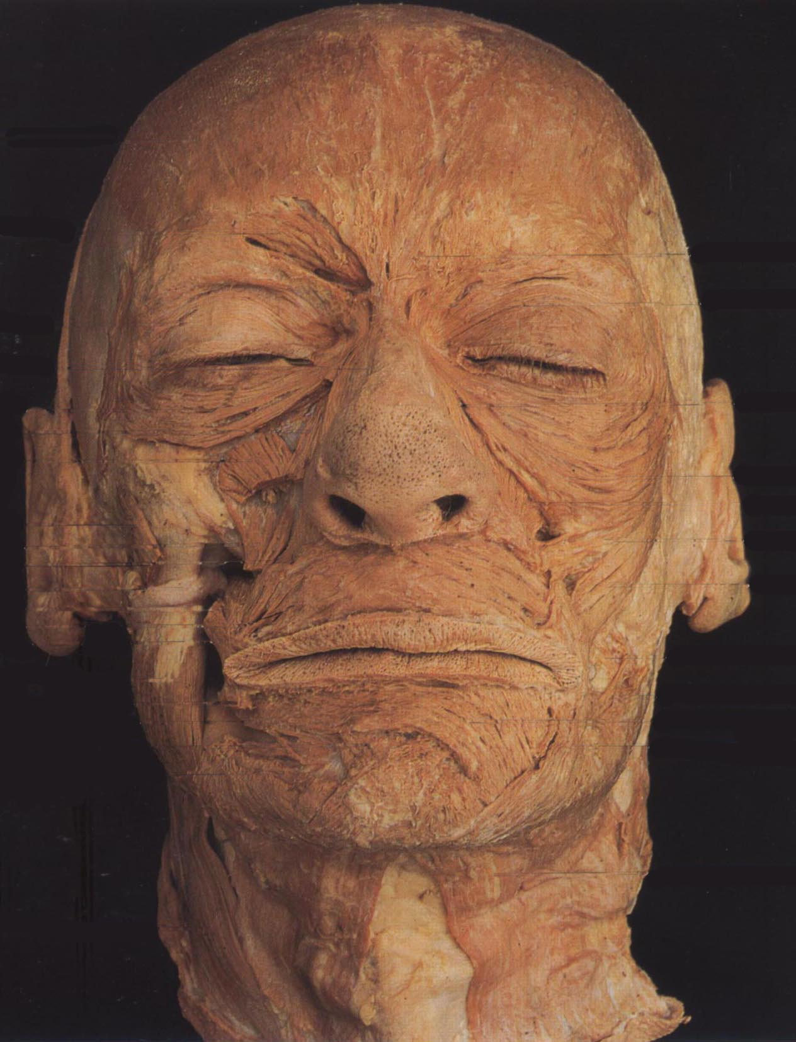

Slide 27
Muscles of the Face
Orbital group
Nasal group
Oral group
Other muscle groups

Slide 28
Muscles of the Face

Slide 29
Orbital group
Two muscles are
Orbicularis oculi
Corrugator supercilii

Slide 30
Orbicularis oculi
3 parts-
Orbital part(outer)
Originate from medial part of medial palpebral ligament and form concentric rings, return to point of origin
Action –closes the lids tightly
Palpebral part(Inner)
Originate from lateral part of medial palpebral ligament
Insert into lateral palpebral raphe
Action-closes the lids gently
Lacrimal part(Small)
Originate from lacrimal fascia& lacrimal bone
Insert into upper &lower tarsi
Action-dilate lacrimal sac

Slide 31
Orbicularis oculi

Slide 32
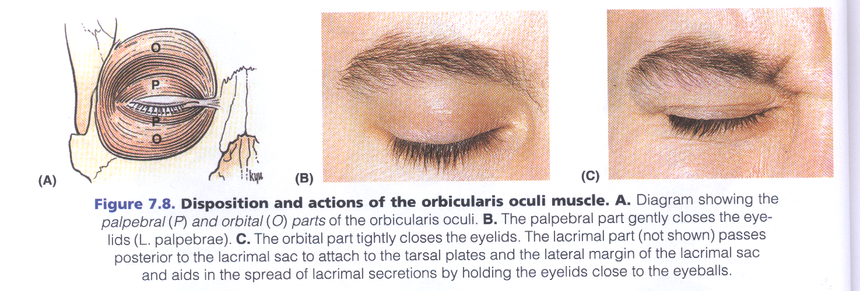
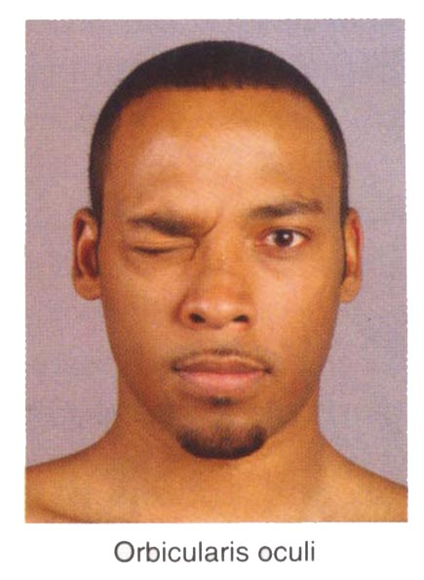
Orbicularis oculi
Palpebral part
Orbital part

Slide 33
Orbicularis oculi

Slide 34
Corrugator supercillii
Origin : superciliary arch
Insertion: skin of the eyebrow
Action: produces vertical wrinkles of the forehead in frowning as an expression of annoyance

Slide 35
Nasal group
Three muscles are associated with the nasal group:
Nasalis
Procerus
Depressor septi nasi

Slide 36
Nasal group

Slide 37
Compressor naris
Origin: Frontal process of the maxilla
Insertion: Aponeurosis which crosses the bridge of the nose
Action: Compresses the mobile nasal cartilages

Slide 38
Dilator naris
Origin : Maxilla bone
Insertion: Ala of the nose
Action: Widens the nasal aperture (by pulling the alar laterally) in deep inspiration; is also a sign of anger

Slide 39
Procerus
Origin: nasal bone and lateral nasal cartilage
Insertion: skin between the eyebrows
Action:
pulls down the medial end of the eyebrow
wrinkles the skin of the nose transversely in frowning

Slide 40
Oral group
The muscles in the oral group move the lips and cheek:
Orbicularis oris
Buccinator
Lower group of oral muscles
depressor anguli oris
depressor labii inferioris
Mentalis
Upper group of oral muscles
risorius
zygomaticus major and zygomaticus minor
levator labii superioris
levator labii superioris alaeque nasi
levator anguli oris

Slide 41
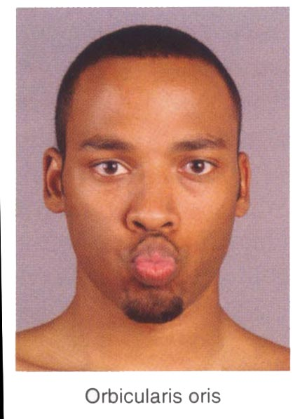
Orbicularis oris
Origin: from maxilla above incisor teeth
Insertion: into skin of lip.
Action: closes the mouth

Slide 42
Buccinator
Upper fibers
Origin- from maxilla opposite molar teeth
Insertion-upper lip
Lower fibers
Origin-from mandible opposite molar teeth
Insertion-lower lip
Middle fibers
Origin –from pterigomandibular raphe
Insertion-decussate before passing to lips
Action- it aids in mastication by prevent accumulation of food in vestibule of mouth. It is used every time air expanding the cheeks is forcefully expelled

Slide 43
Other muscle groups
They include:
Platysma
Auricular (anterior, superior, and posterior auricular muscles)
Occipitofrontalis

Slide 44
Platysma
Origin– upper part of pectoral and deltoid fascia
Insertion– base of mandible, skin of lower face and lip
Action– releases pressure of skin on the subjacent veins, depress mandible, pulls angle of mouth downwards.

Slide 45
Muscles of the Face

Slide 46
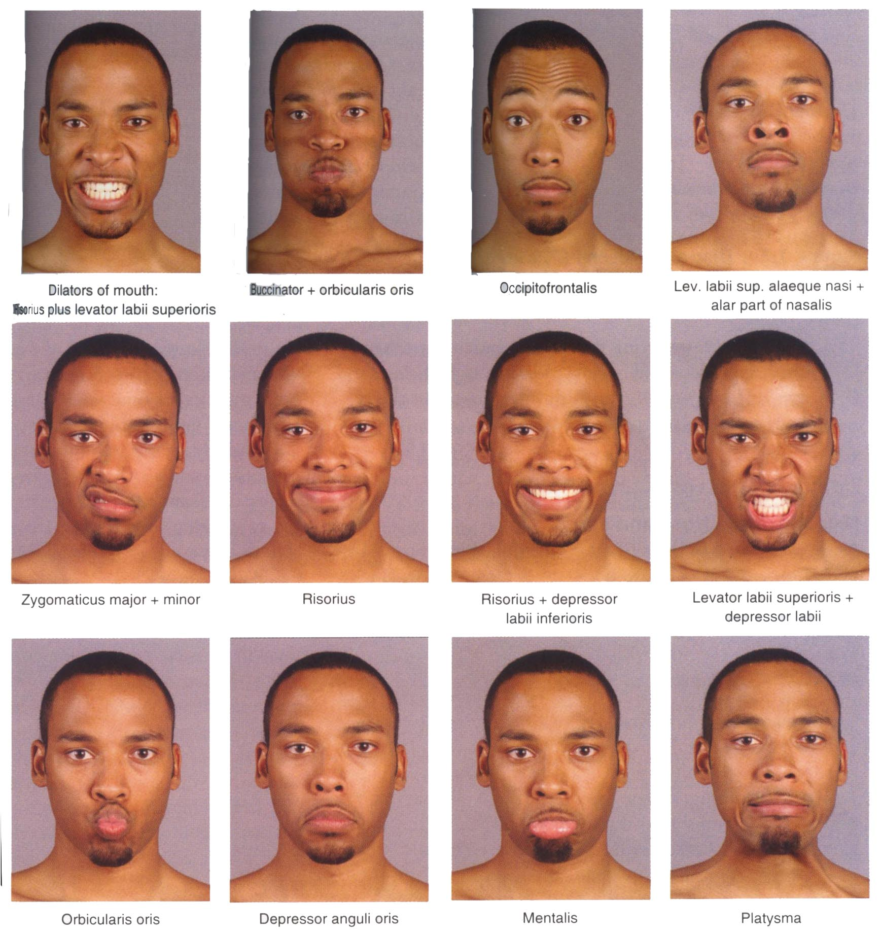

Slide 47
Blood Supply and Pulses in Face
Internal carotid
Supraorbital artery
Branch of ophthalmic
External carotid
Superficial temporal artery
Facial artery

Slide 48
Venous Drainage of Face
Supraorbital and anterior facial veins
Communicate superior ophthalmic veins which drain into cavernous sinus
Deep facial vein
Superficial temporal vein
Retromandibular vein
Common facial vein

Slide 49
Emissary Veins
MOB TCD
They are small valveless veins pass via foramina in the skull and connect the veins outside the skull and dural venous sinuses.
Function: they help to equalize the pressure in vein outside the skull and in the dural venous sinuses.
Their danger :infection outside the skull may spread along the emissary veins to reach the dural venous sinuses and produce sepsis
2 sets of emissary veins
1- Parietal emissary vein through parietal foramen communicates the scalp veins with superior sagital sinuses.
2- Mastoid emissary veins through mastoid foramen communicates the scalp veins with sigmoid sinuses

Slide 50
Lymph Glands
Submental
Submandibular
Buccal and mandibular
Preauricural
Postauricular
Occipital

Slide 51
Sensory Nerves of the Face
The skin of the face is supplied by the trigeminal nerve (V), except for the small area over the angle of the mandible and the parotid gland which is supplied by the great auricular nerve (C2 and 3).
The trigeminal nerve (V) divides into three major divisions-the ophthalmic (V₁), maxillary (V₂), and mandibular (V₃) nerves

Slide 52
Sensory Nerves of the Face

Slide 53
Sensory Nerves of the Face

Slide 54
Testing the Integrity of the Trigeminal Nerve (temperature & pain)

Slide 55
Motor Nerves of the Face
Motor supply:
Facial nerve
Facial nerve divides into five terminal branches for muscles of facial expression:
Temporal
Zygomatic
Buccal
Marginal mandibular
Cervical

Slide 57
Applied
Trigeminal neuralgia
Maxillary and mandibular nerve are involved
Excruciating pain in the region of distribution of these nerve
In infranuclear lesions of facial nerve (eg, bell’s palsy)- whole face is paralyzed
Clinical features
Affected side is motionless
Loss of wrinkles
Eye cannot be closed
In smiling the mouth is drawn to normal side
During mastication food accumulates in vestibule of mouth

Slide 58
bell’s palsy

Slide 59
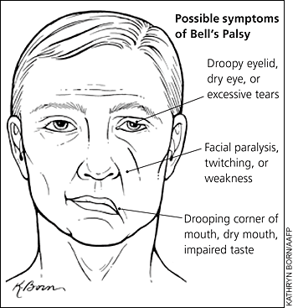

Slide 60
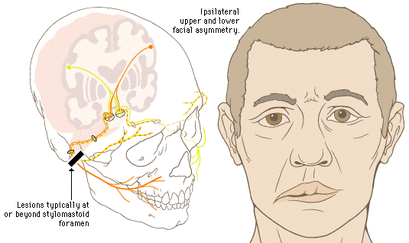
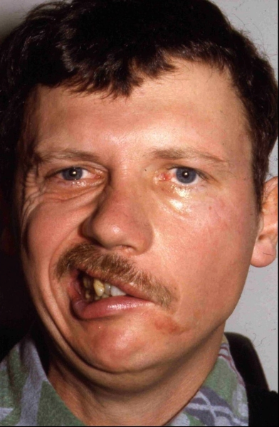
Facial nerve lesion ( Bell’s palsy )

